Slide 1
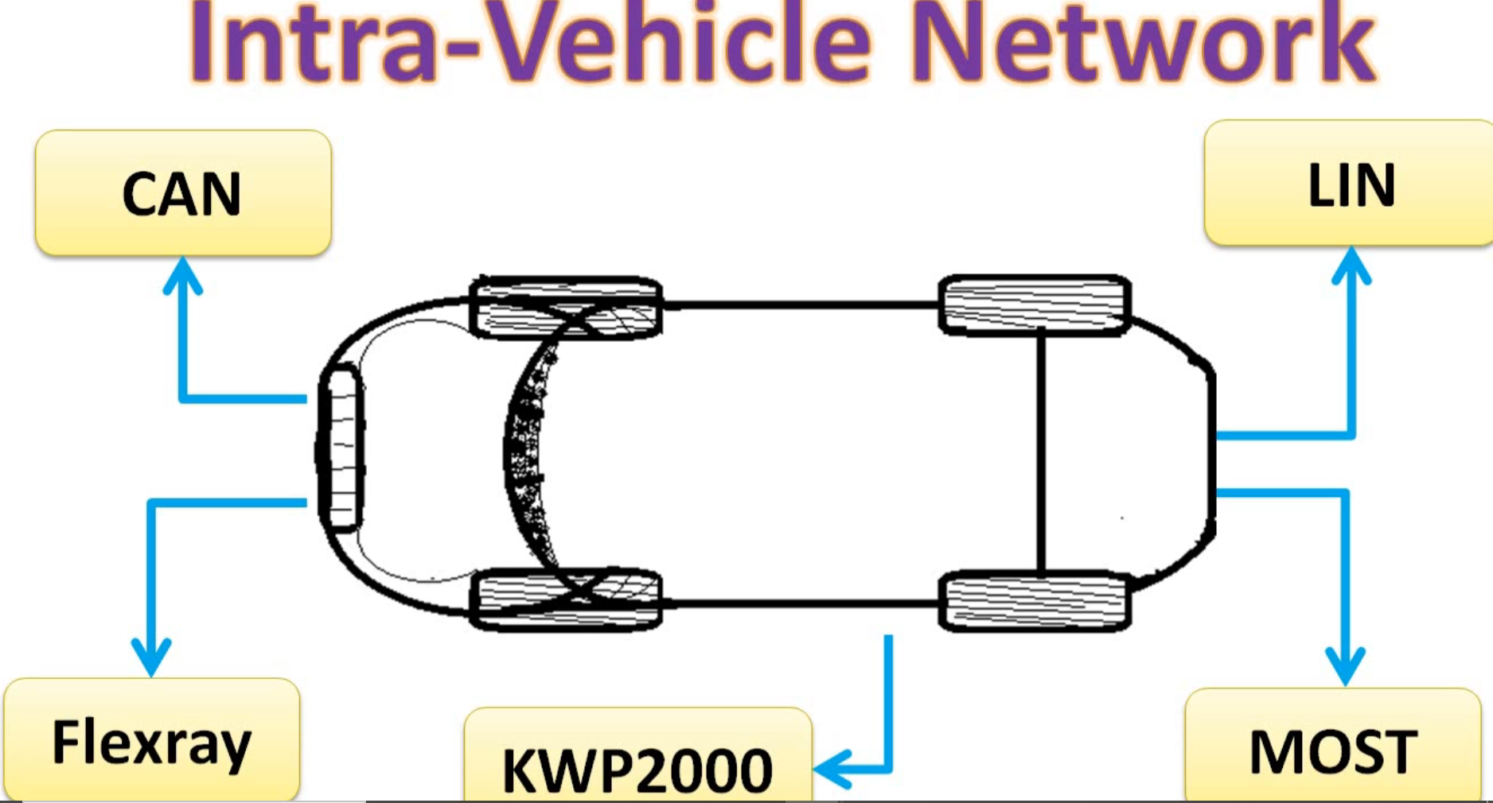

Slide 2
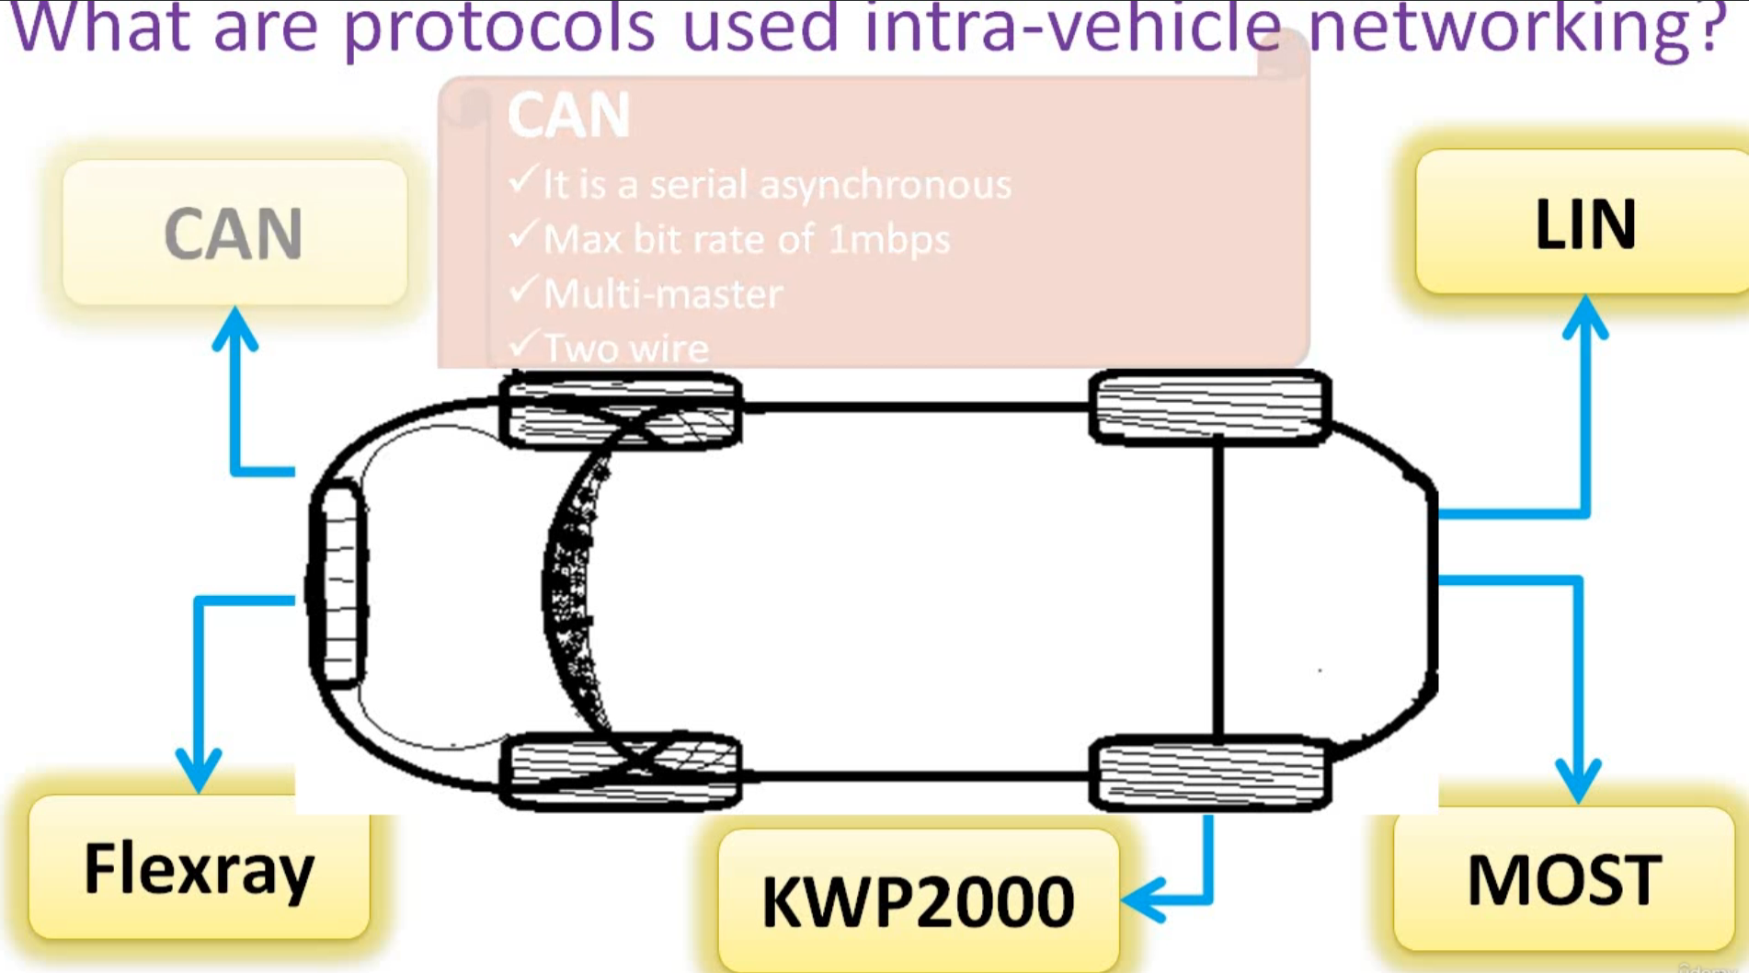

Slide 3
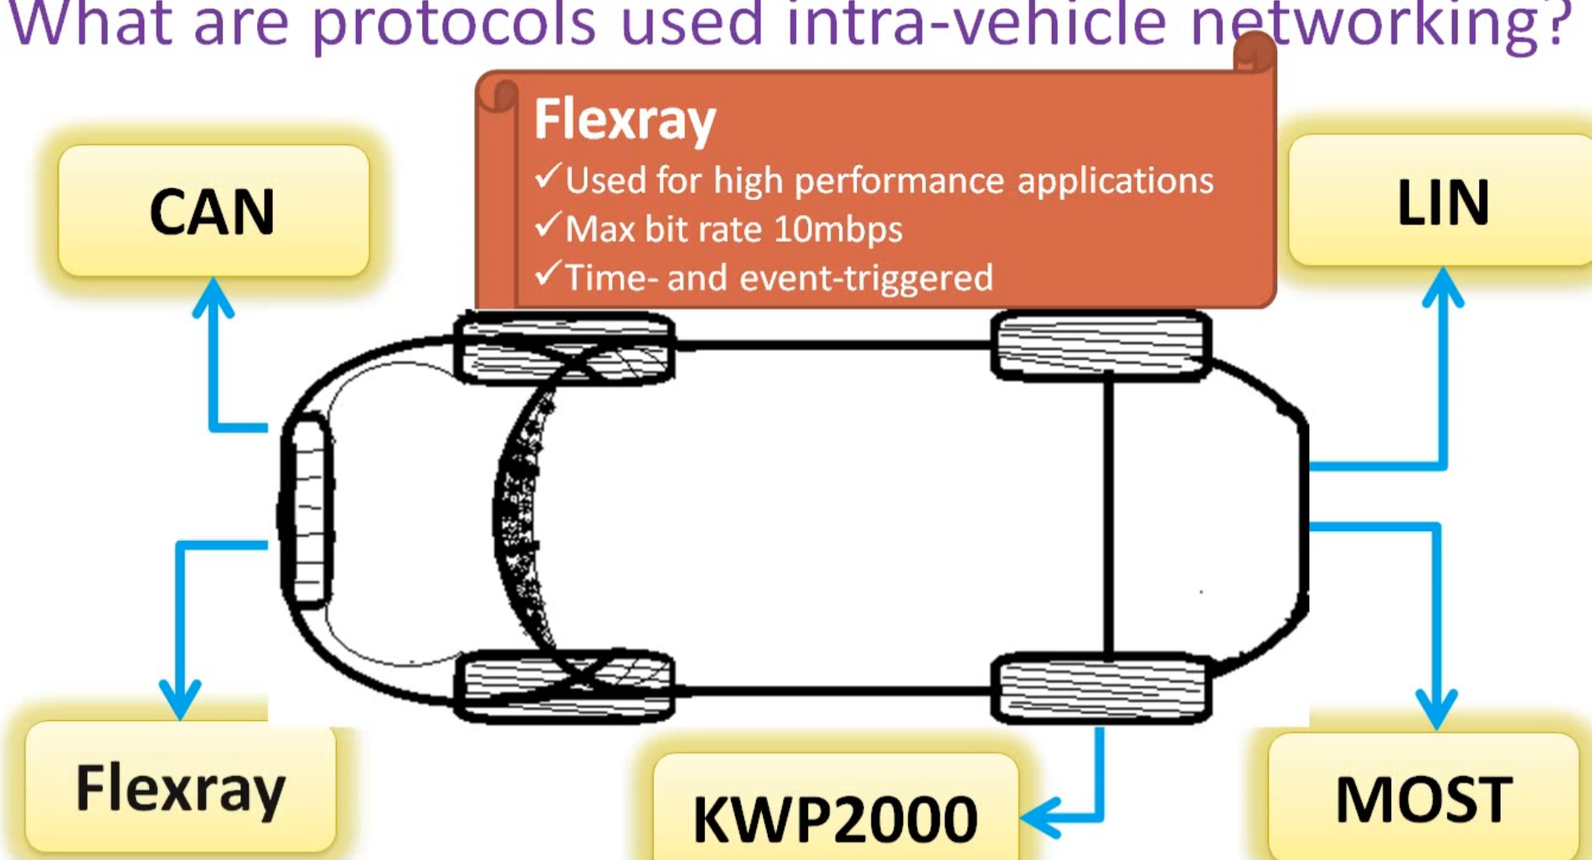

Slide 4
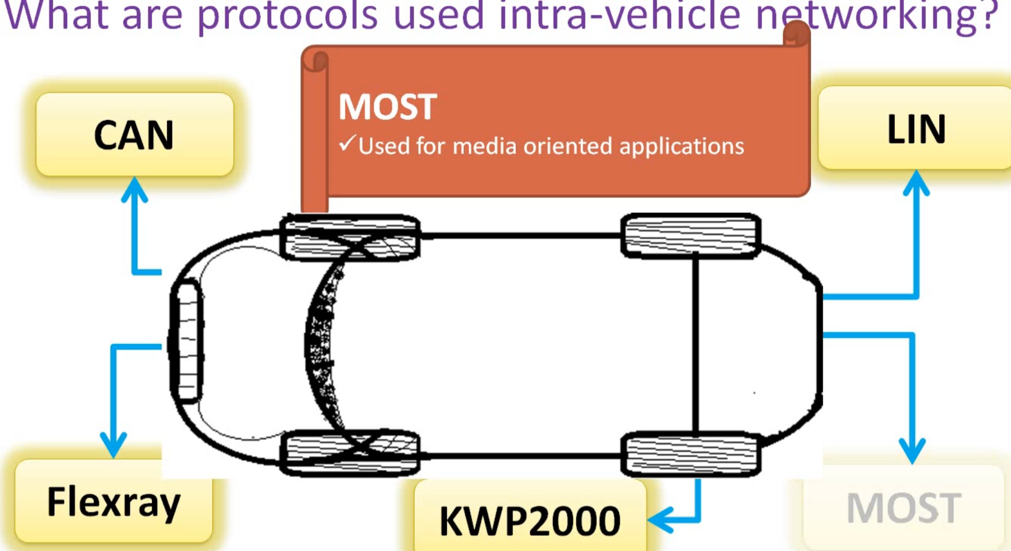

Slide 5
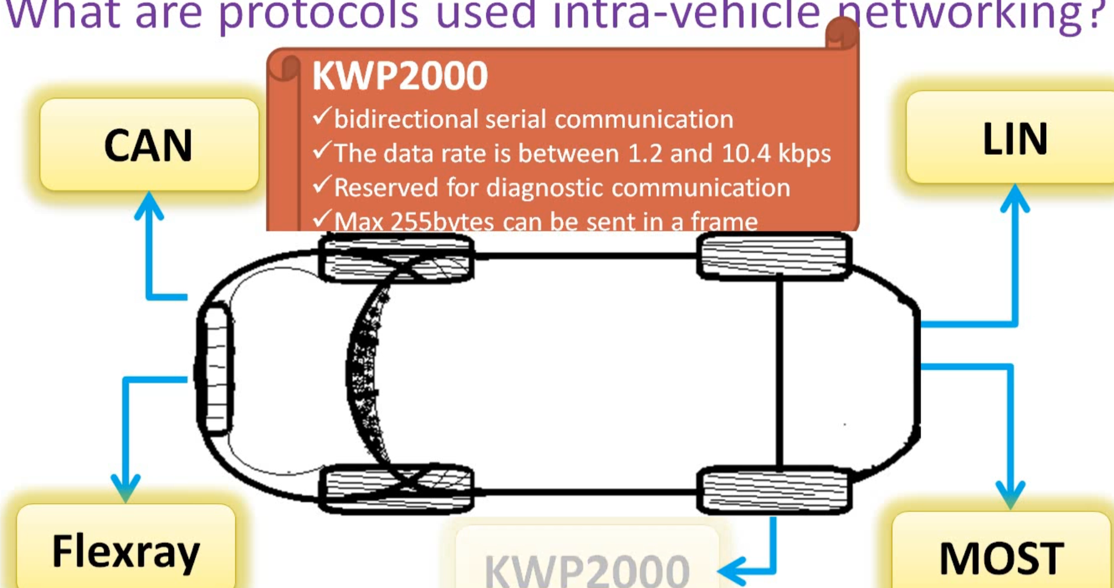

Slide 6
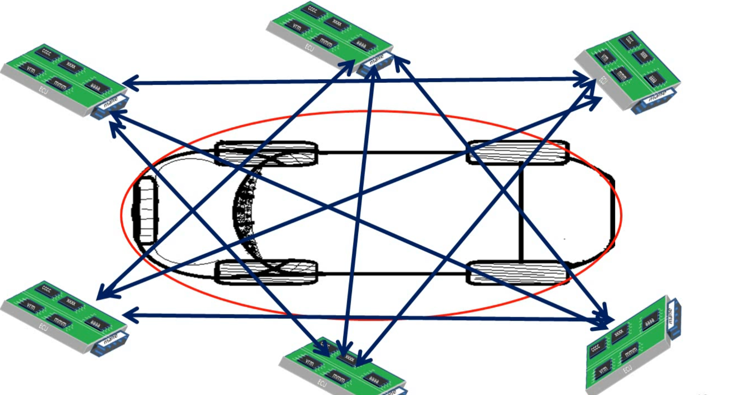

Slide 7
Why LIN?
Overhead Bits
Two Wires
Arbitration
No One control the bus
Latency Time
Separate controller is required.

Slide 8
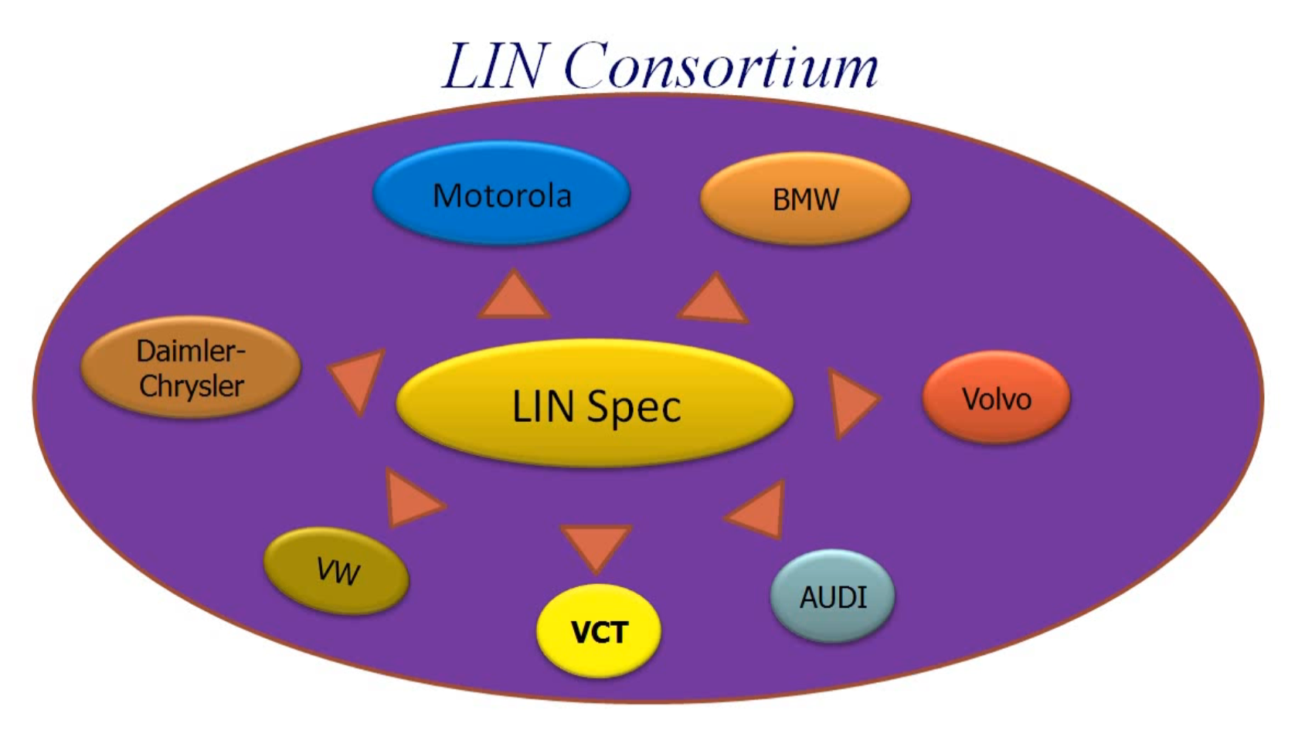

Slide 9
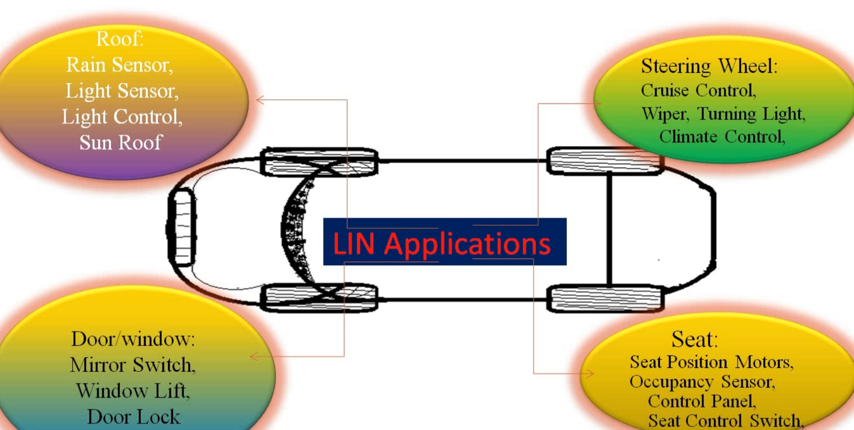

Slide 10
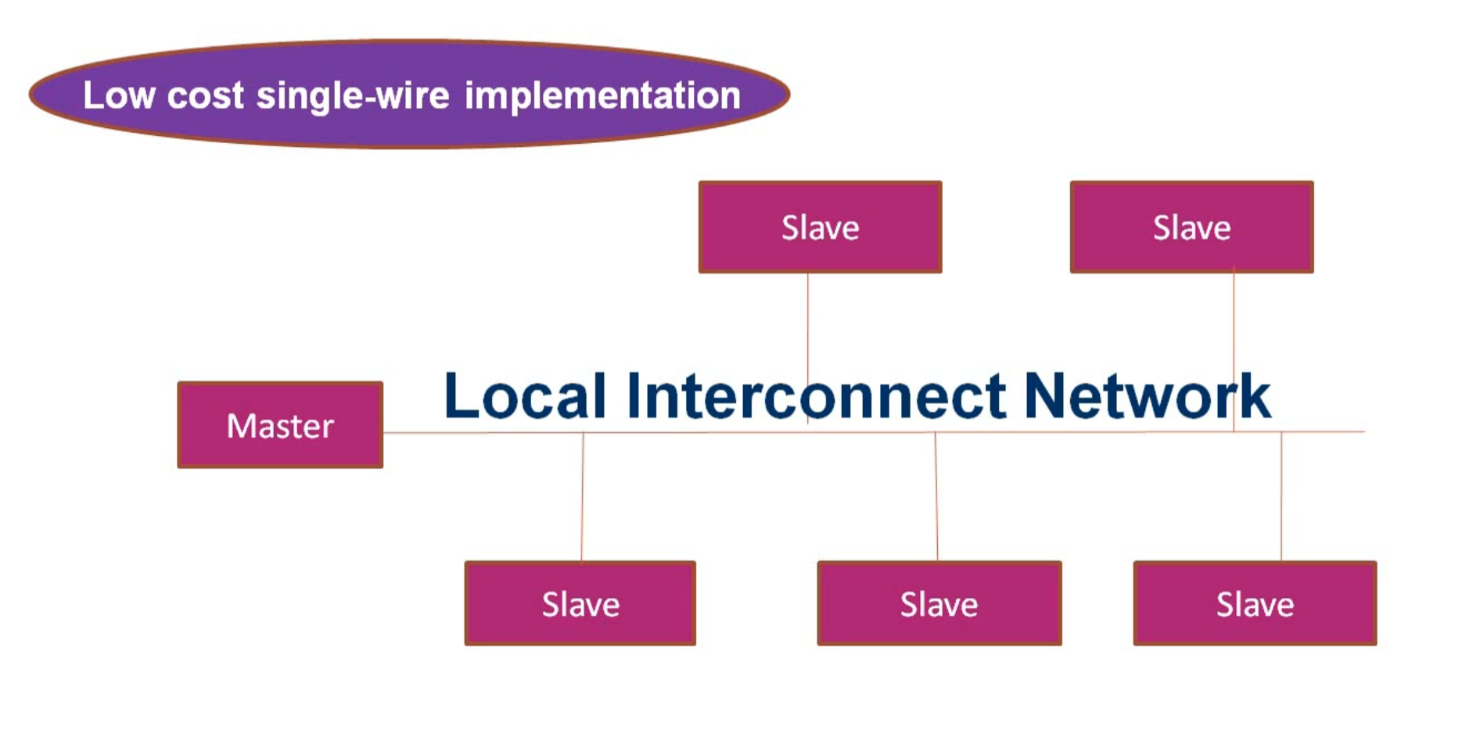

Slide 11
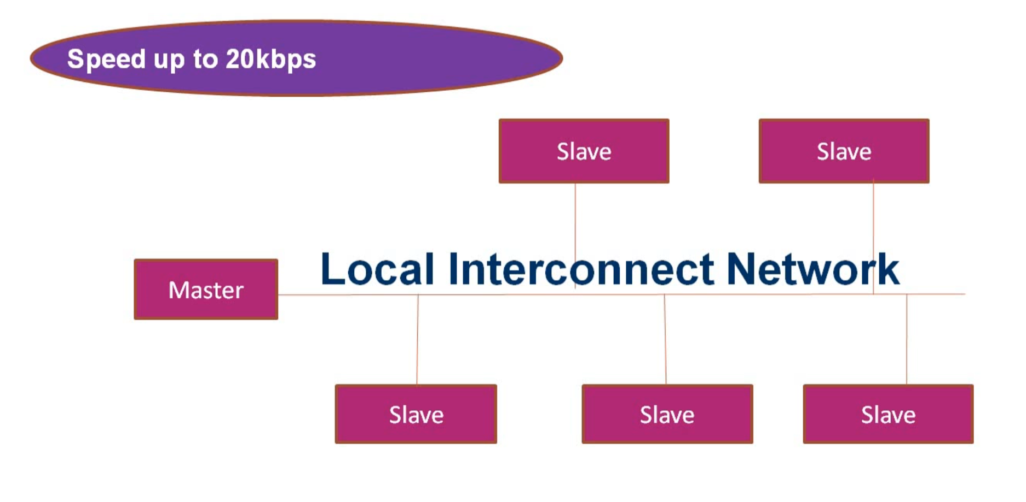

Slide 12
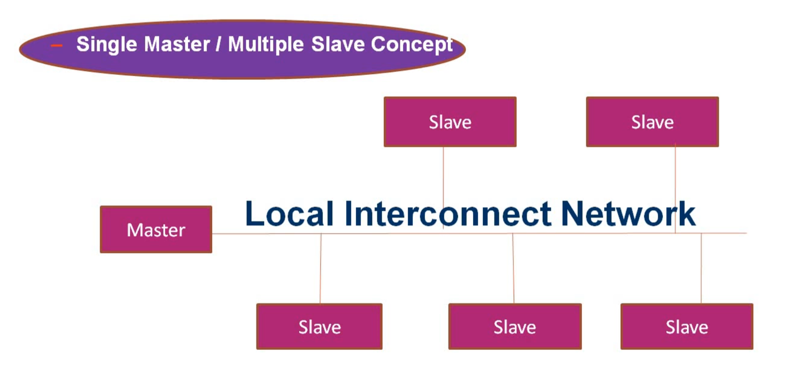

Slide 13


Slide 14
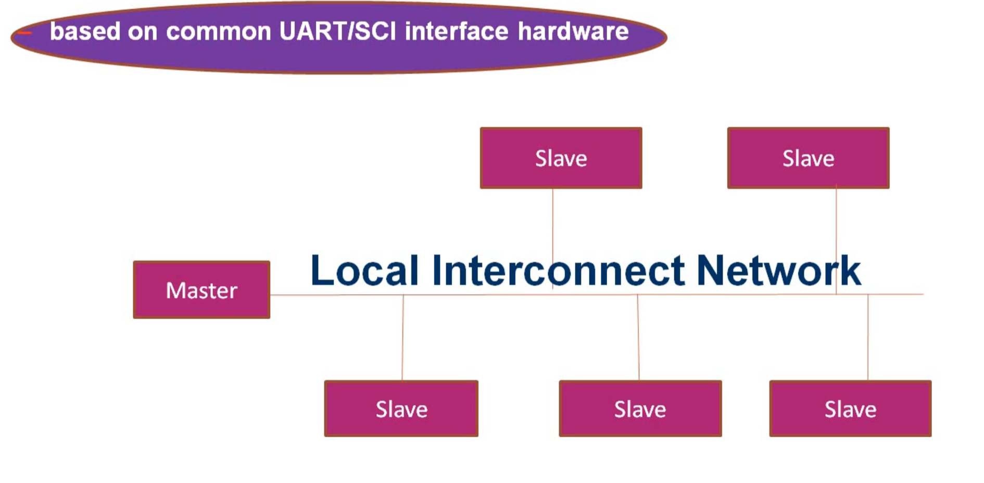

Slide 15
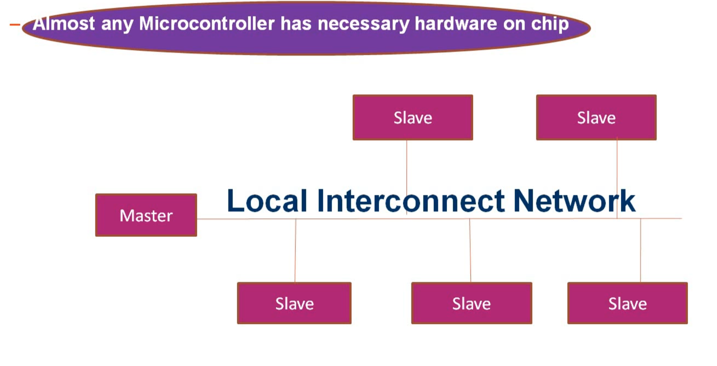

Slide 16
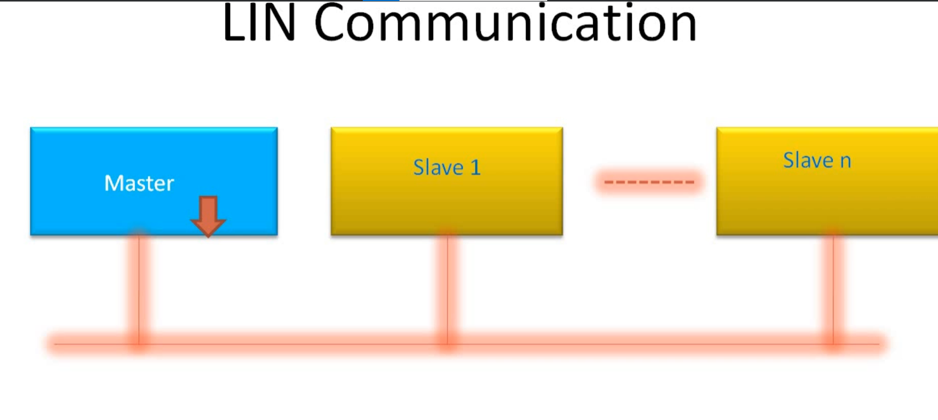

Slide 17
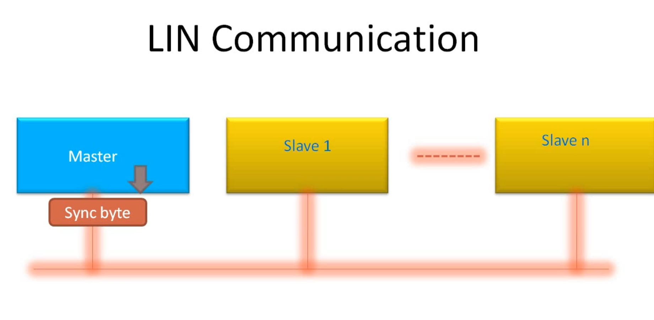

Slide 18
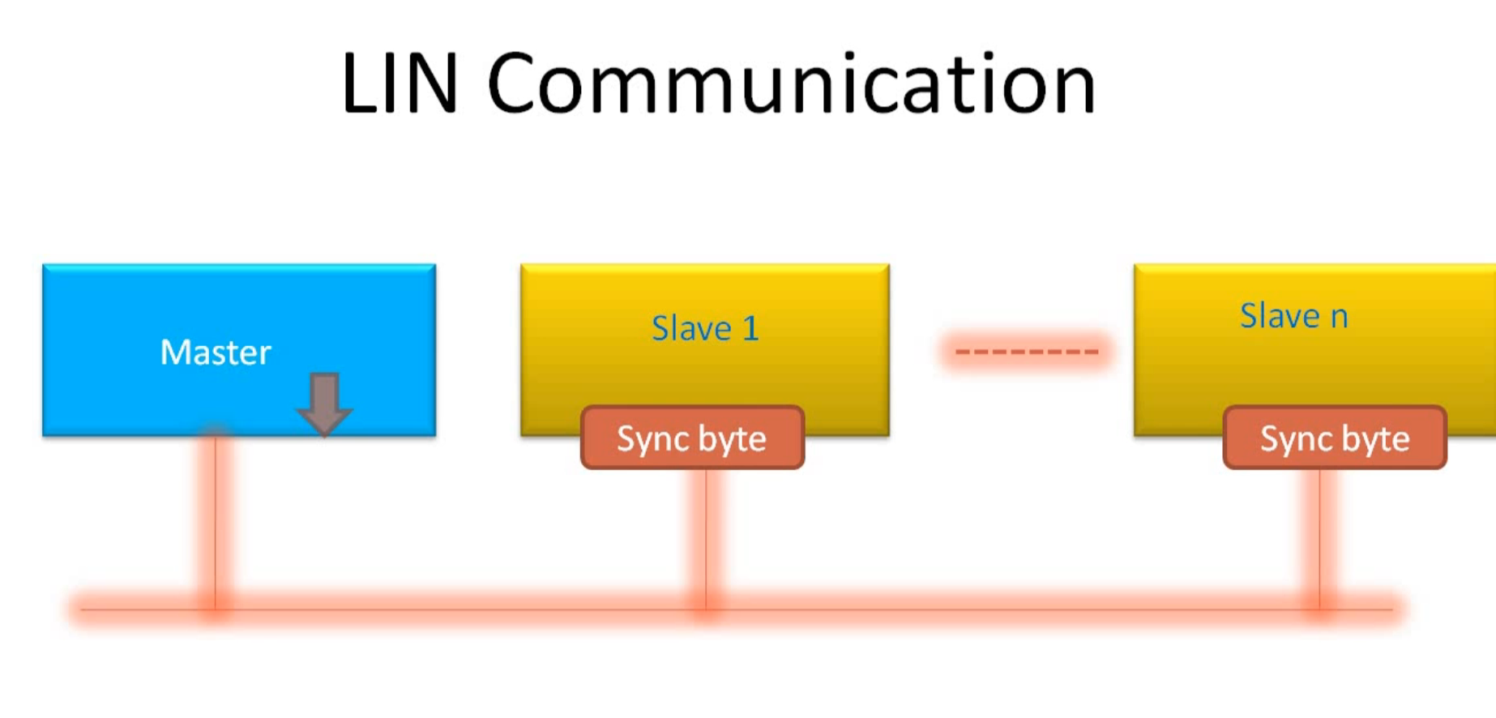

Slide 19
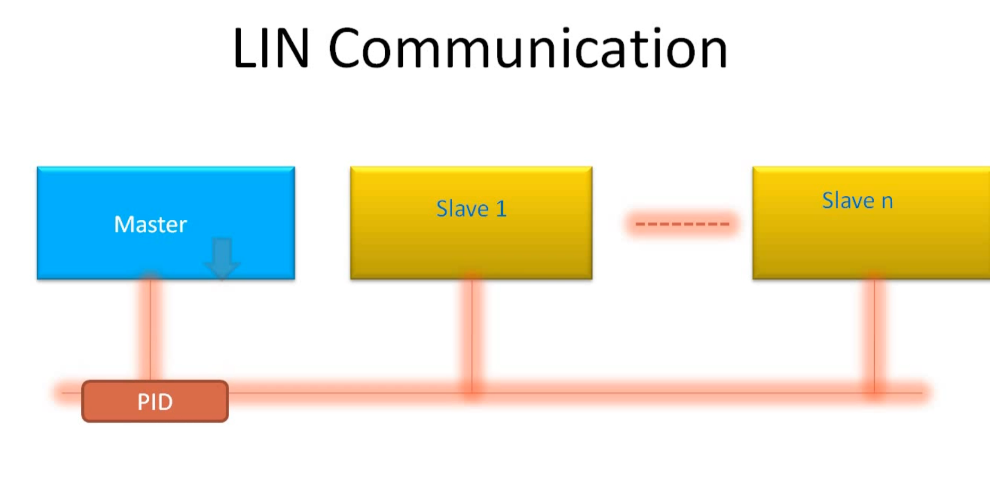

Slide 20
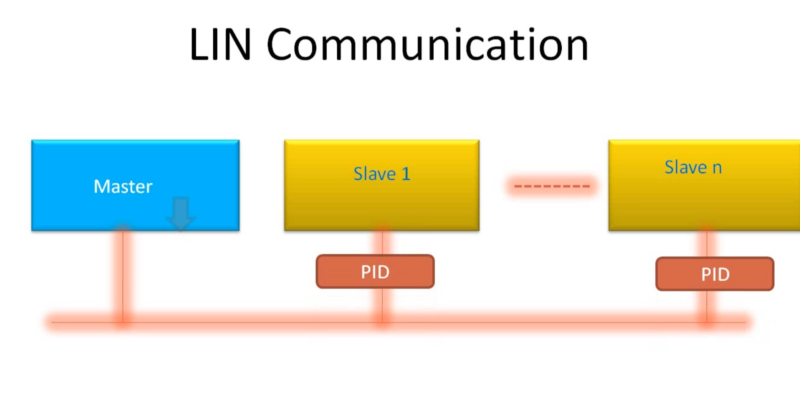

Slide 21
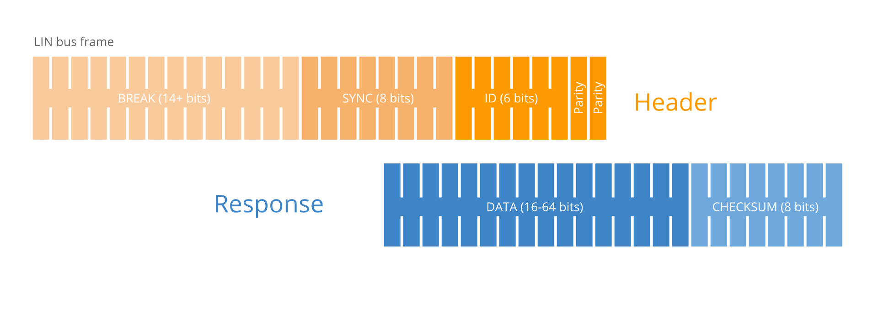

Slide 22
Message Identification CAN
In CAN, each message is assigned a unique identifier, commonly known as a CAN ID or CAN message ID. These IDs are a fundamental part of the CAN message structure and serve several important purposes:

Slide 23
Polling Rate
In CAN, the polling rate is typically defined by the node's software or firmware. Each node can independently set its own polling rate based on its specific requirements. The polling rate determines how frequently a node checks the CAN bus for new messages.

Slide 24
CAN Traffic monitoring
CAN traffic monitoring is the process of observing and analyzing the data being transmitted over a Controller Area Network (CAN). It is a crucial aspect of maintaining and troubleshooting CAN-based systems, particularly in applications such as automotive, industrial automation, and aerospace, where reliable communication is vital. Here's a more detailed explanation of CAN traffic monitoring:

